Slide 1

Close Store
By THaI AN

Slide 2
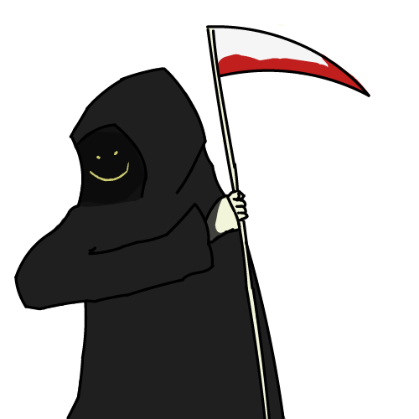
INDEX
MR. REAPER
(AKA LOGO)
PERSONAL INFORMATION
REASON BEHIND THE CREATION
TOOLS
DESIGN
DEMO
Q&A

Slide 3

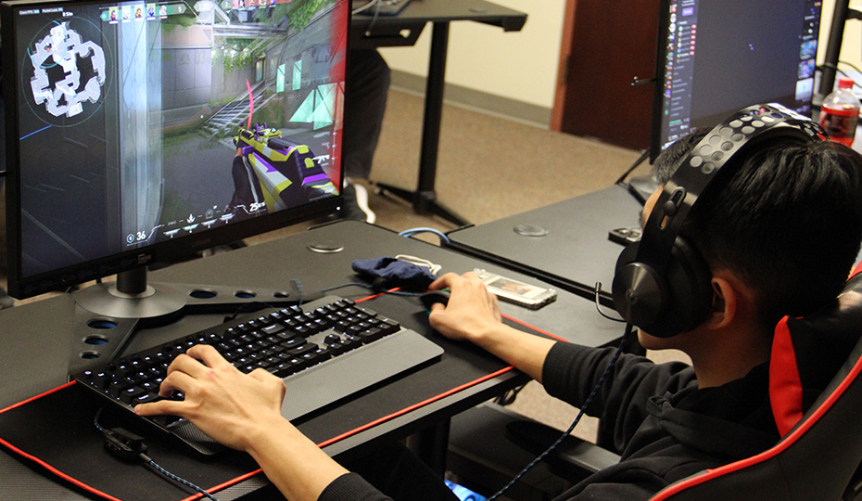
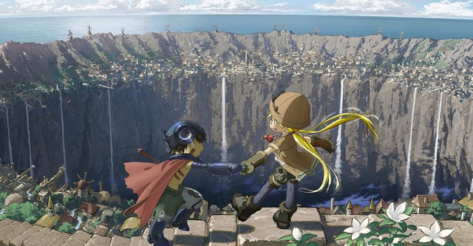
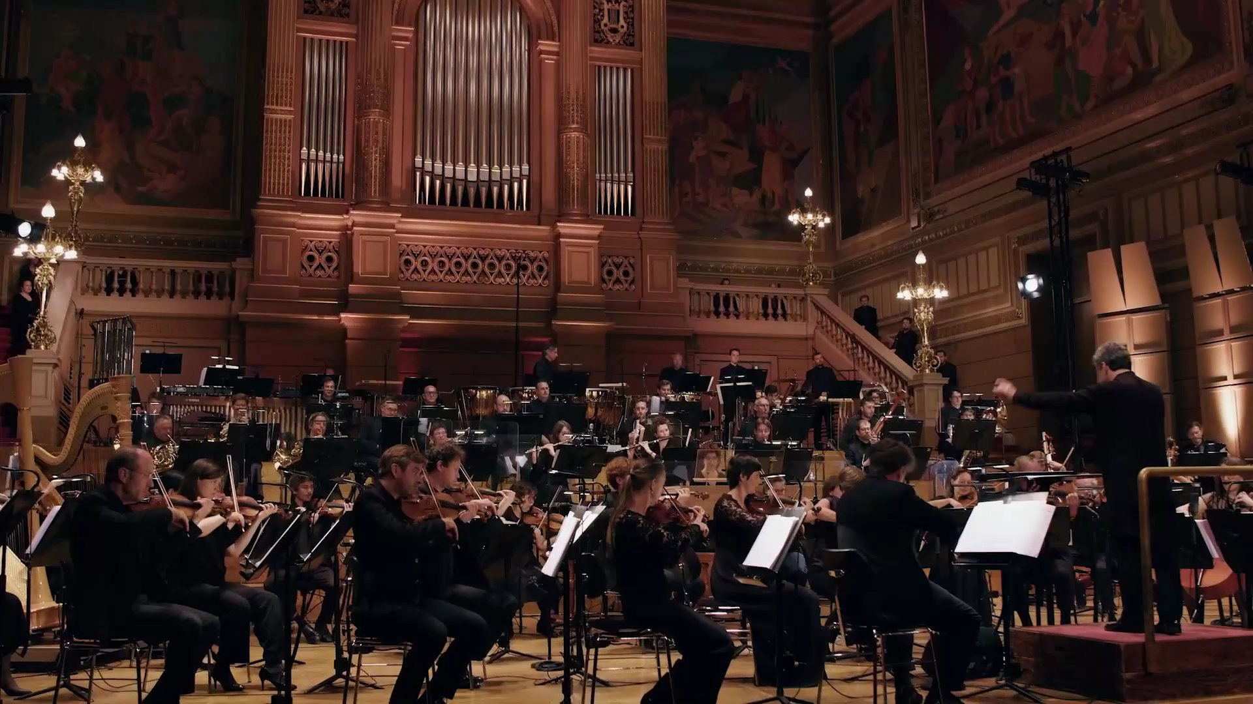
1. PERSONAL INFORMATION
NAME: Nguyen Thai An
CLASS: 10D1
SCHOOL: Yen Hoa High School
HOBBIES & FAVORITE: Video games; Listen to music; Watching film; Read books

Slide 4
2. REASON BEHINd THE CREATION

Slide 5




3. TOOLS
HTML 5
CSS
Java Script
Pixlr Editor

Slide 6
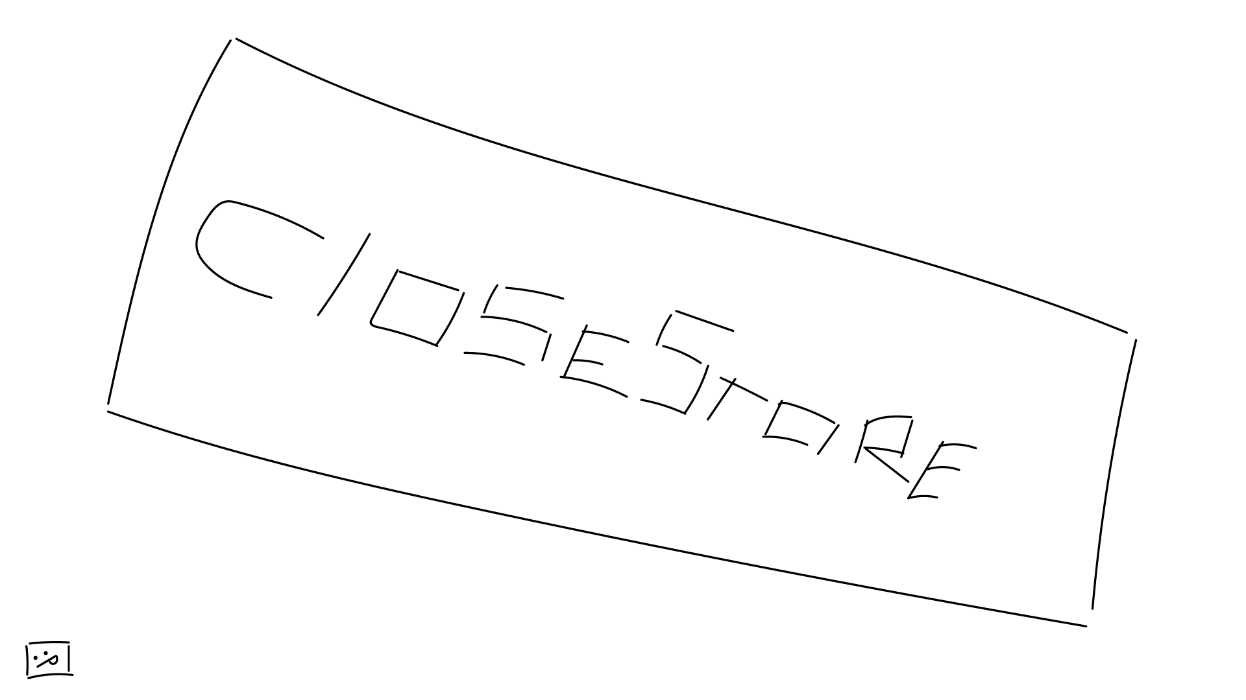
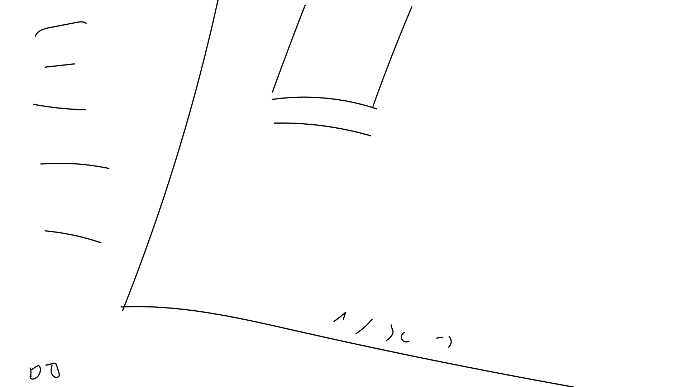
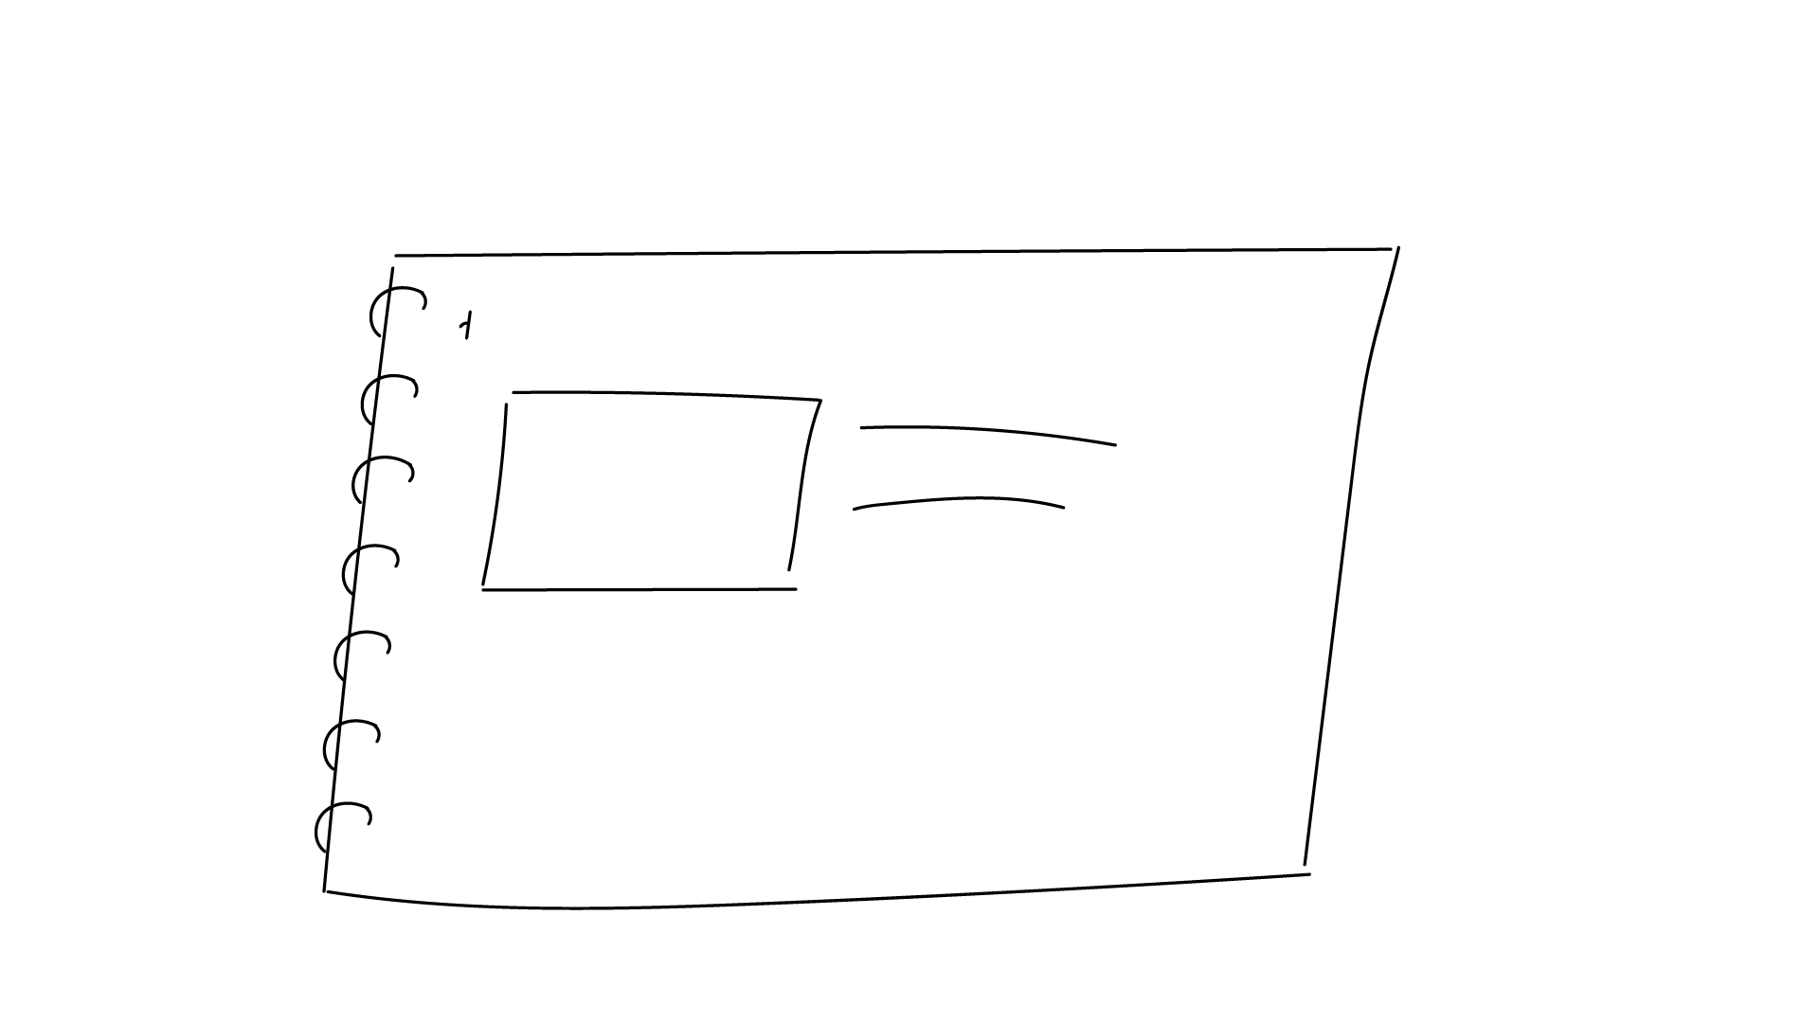
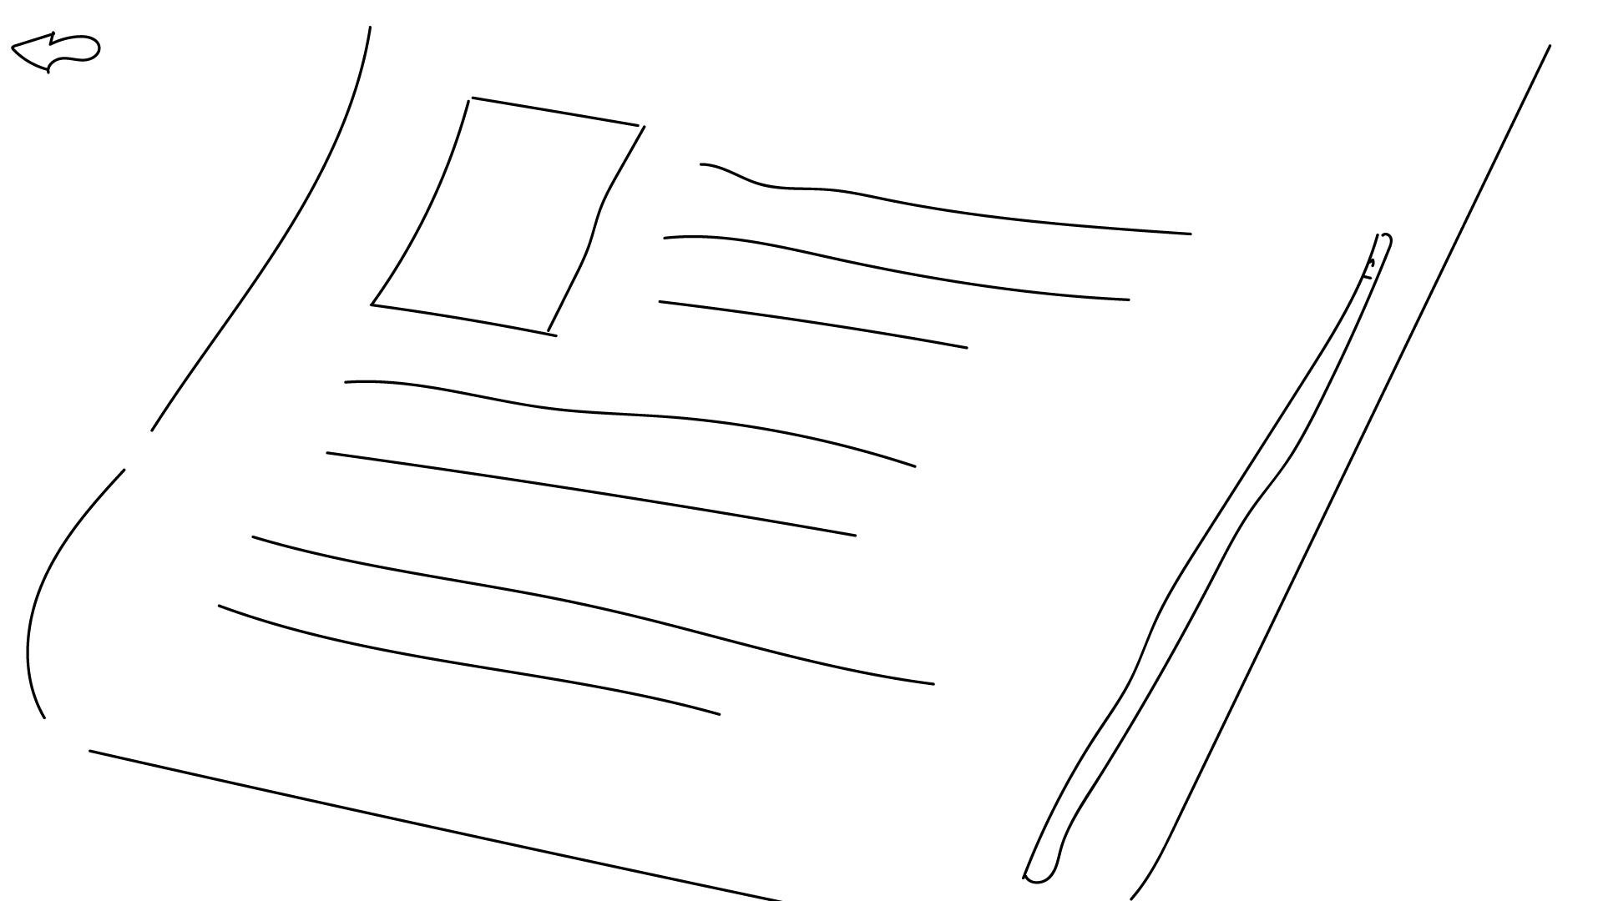
4. DESIGN

Slide 7
5. demo
Reviewing website

Slide 8
6. Q&A
Answering questions

Slide 9



